Slide 1
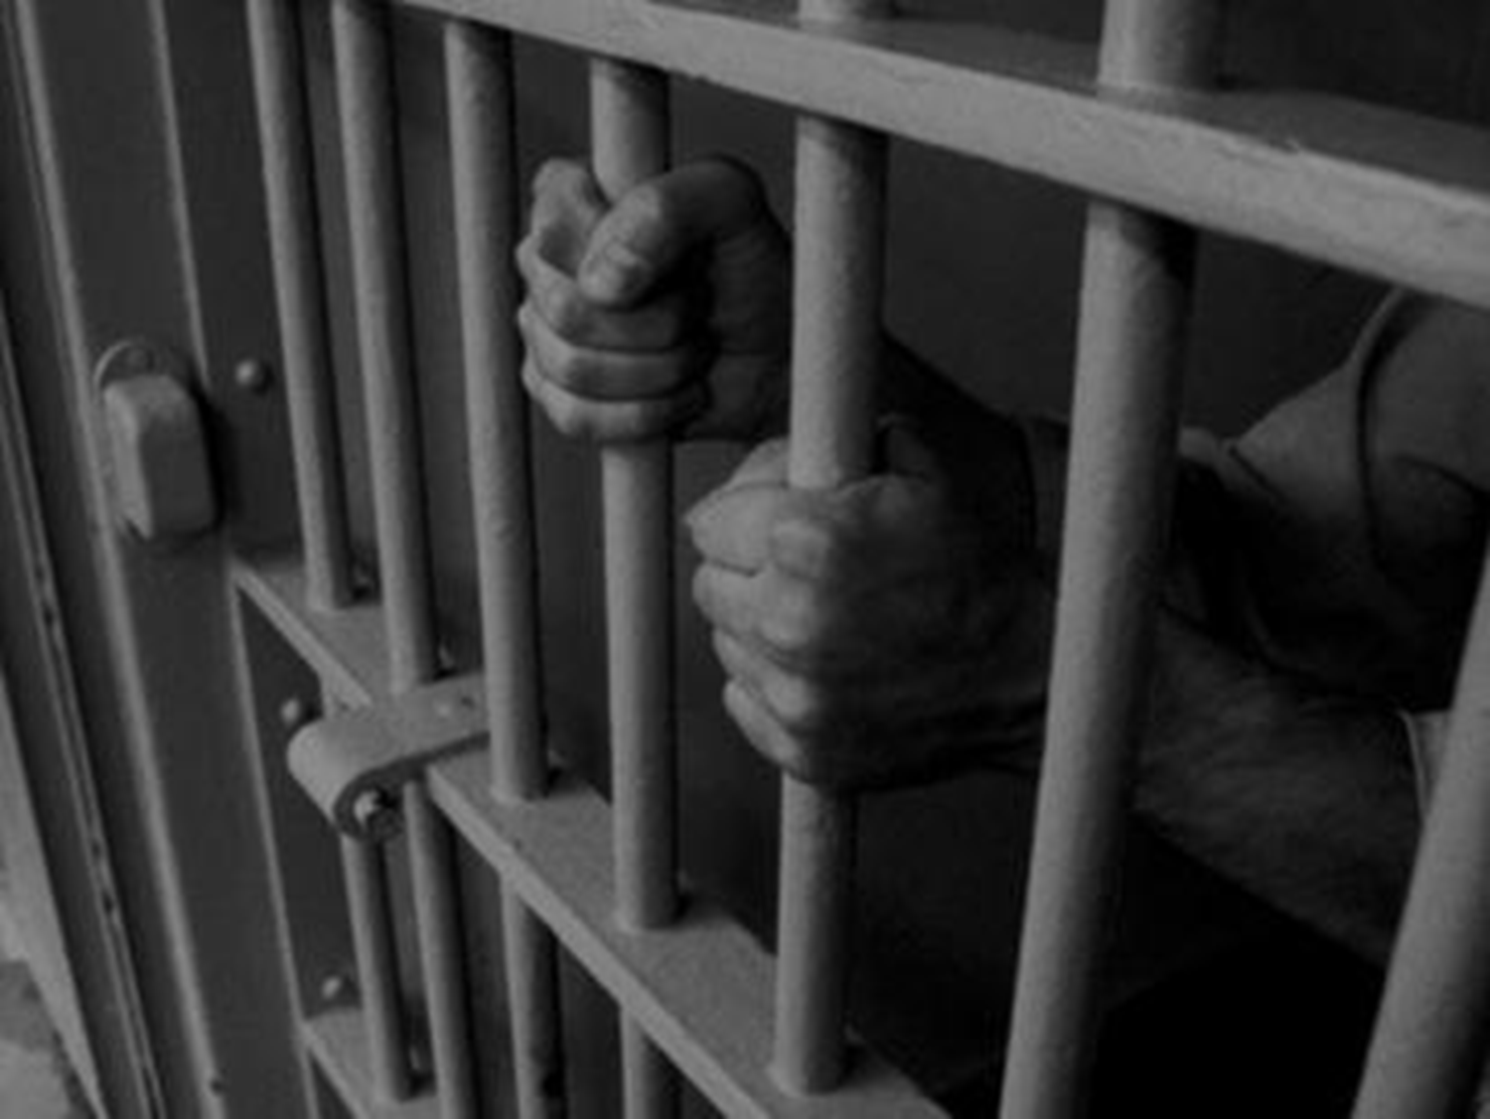
LAW CLINICS IN PRISONS
  - SUGANDHA SHANKAR

Slide 2

3,72,926
India’s prison population as on 31 December 2011

Slide 3
2,41,200
1,28,592
Number of Undertrials
Number of Convicts

Slide 4
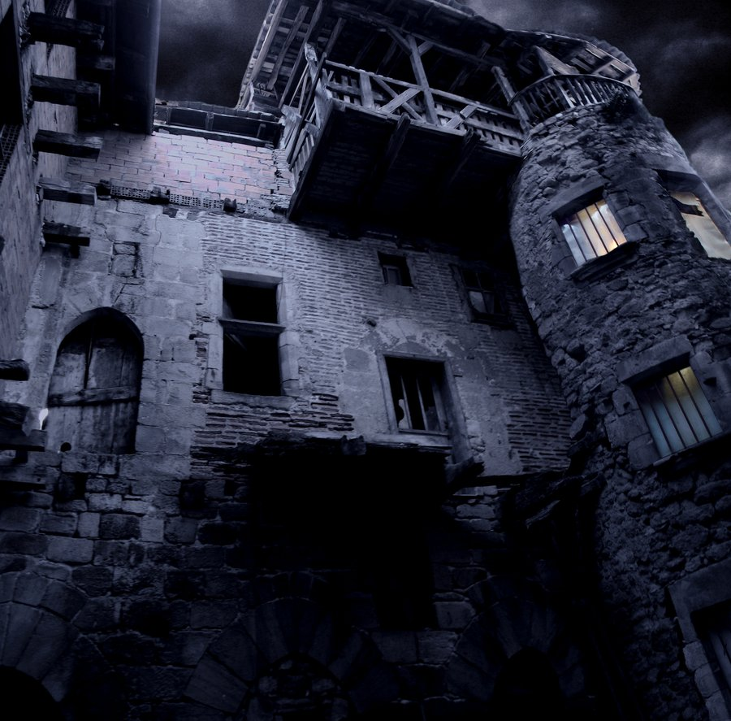
Horrors of Unnecessary Detention

Slide 5
We are jankhalash prisoners from Bangladesh. Our sentence is done. Why are we still here?
Why has my chargesheet not been filed yet? 60 days are over & you still want to keep me?
I am from another state. I have no one to provide surety even if Court has granted me bail
Remanding
me to Judicial Custody AGAIN??
The court has not appointed a legal aid lawyer for me though I am poor…how do I get bail?
I was in the court lock up… The magistrate did not ask for my physical production
My case must have been reviewed by the PRC since I am a petty offender and have been in jail for 14 months
My lawyer
has not come to meet me in prison for 10 months now
Will the Judge ever visit us in the prison?
There was no police escort to take me to court … they kept sending my warrant instead
The police beat me up and produced me in court after 4 days. My family knew nothing
I am Late Balu Ram.
I spent 36 years in prison but my trial could not be completed.
My fault: I was mentally ill

Slide 6

LEGISLATURE
Article 22(1), Constitution of India
Article 39(A), Constitution of India
Section 304, Code of Criminal Procedure
Article 142, Constitution of India
VISION

Slide 7

JUDICIARY
Ranchod Mathur Wasawa v. State of Gujarat (1974) 3 SCC 581
Khatri v. State of Bihar AIR 1981 SC 928
Hussainara Khatoon (II) v. State of Bihar AIR 1979 SC 1369
Ranjan Dwivedi v. Union of India (1983) 3 SCC 307
VISION

Slide 8

GOVERNMENT
GOI’s Draft Policy Paper on Prisons (Letter No.17014/3/2009-PR)
Point 13 – Legal Aid Facility
Legal Aid Cell in each prison shall be maintained to help in processing the legal aid applicants
NGOs and Law students could be encouraged to contact the prisoners and their families on a regular basis to fulfill the requirements of approaching the court
VISION

Slide 9

OTHER BODIES
Mulla Committee 1983 – Rights of Undertrials including facilities of access to legal aid should be protected (Rec 349)
Model Prison Manual 2003 - The facilities that should be extended to all undertrial prisoners include legal defence, interviews with lawyers or family members, application to courts for legal aid at government cost as per provisions of law, and application to Legal Aid Societies for free legal aid (Ch.22.10)
VISION

Slide 10
LEGAL SERVICES AUTHORITIES ACT, 1987
NALSA
SLSA
DLSA
National Legal Service Authority Chief Justice of India
State Legal Service Authority
Chief Justice of the High Court
District Legal Service Authority District Judge

Slide 11
MANDATE OF LSAs
  To provide free and competent legal services to eligible persons
  To hold Lok Adalats
  To conduct legal awareness programmes
Persons Eligible for Legal Aid (Section 12)
Member of SC/ST
Woman / Child
Human Trafficking / Beggar
Disabled Person
Mass Disaster Victim
Industrial Workman
PERSON IN CUSTODY
Economic Means Test
Notes:
11

Slide 12
CHRI
Evidence building
LAW COLLEGE
Real-life Work Experience
PRISON
LSA
Fosters Professionalism
Spirit of Public Service
Source of Remission
Better Prison Management
Mandate fulfilled
Better Implementation of Schemes
Hands-on Information
No Overcrowding
Institutionalizing
Building capacity
Monitoring Tool
LAW CLINIC

Slide 13
ACTION PLAN
Activity Plan
Identifying local partners
Access to Prisons
Signing of MOUs
Orientation of Students
Launch the Law Clinic
Regular Periodic Visits
Review of Cases
Referrals to Authorities
Follow-up & Informing Clients

Slide 14
Court Observation
Family Connect
Legal
Awareness
Reading
Materials
Micro-
Studies
Network of NGOs
OFFSHOOTS OF LAW CLINICS

Slide 15
WEST BENGAL (Kolkata) LAW CLINIC
SHADHINOTA (Freedom)
Started in August 2010 with National University of Juridical Sciences (NUJS)
Weekly visits by students & CHRI Staff to Dum Dum & Presidency CCHs
Main Issues – Legal aid, Repatriation of Bangladeshi Nationals, Juveniles & First Production
Since March 2012, out of 227 inmates assisted, 64 have got bail, 32 were released and 2 were acquitted
PIL on Repatriation of Bangladeshi Nationals

Slide 16
RAJSTHAN (Jodhpur) LAW CLINIC
SWADHIKAAR (My Rights)
Started in August 2012 with National Law University (NLU), Jodhpur
Weekly visits by students & CHRI Staff to Central Prison, Jodhpur
58 inmates got legal aid lawyers; 2 cases referred to JJB, CWC; 12 persons connected to families
DLSA initiated a legal aid clinic
Main Issues – Legal aid, Releasing on Personal Bond, Custodial Violence, Reviving the Periodic Review Committee

Slide 17
CHALLENGES FACED
1
Collaboration & Coordination with the Law Schools
2
Coordination with the local lawyers
3
Follow-up with the Prison and DLSA
4
Issues relating to material conditions in prison avoided
5
Sustaining and institutionalizing the legal aid initiative

Slide 18

Behind Bars Not Beyond Justice
Thank you!
Prison Reforms Programme
Commonwealth Human Rights Initiative

